Slide 1



Multithreading
www.cybage.com
Copyright © 2019 Cybage Software Pvt. Ltd. All Rights Reserved. Cybage Confidential. www.cybage.com

Slide 2
Agenda
What is thread ? Why threads ?
Thread Scheduling
Ways of creating threads in Java
Thread lifecycle and methods
Thread Synchronization
Inter-thread communication
www.cybage.com

Slide 3
Concurrency
Concurrency is the ability to run several parts of a program or several programs in parallel.
Concurrency can highly improve the throw-put of a program if certain
tasks can be performed asynchronously or in parallel.
Concurrency can be achieved through
Multiprocessing
or
Multithreading
Java provides support for Multithreading
www.cybage.com

Slide 4
Multiprocessing Vs Multithreading
Multiprocessing : No. of processes(programs) run simultaneously
Multithreading
: It is a technique that allows a program or a process to execute many tasks concurrently (at the same time and parallel).
Which of the two is light weight ? …Why?
www.cybage.com

Slide 5
Thread
Entire task (a java process ) can be divided into subtasks and those subtasks
can be executed concurrently. One Thread corresponds to one subtask
A thread is an entity within a process
Example : MS Word : In this single process, no. of activities are carried out simultaneously like saving of file, reading input, spell-checking
www.cybage.com

Slide 6
Thread Continued..
Thread is a class in java.lang package
You can create your own thread type in two ways
extend from Thread class
or
implement Runnable interface
•
Constructors of Thread class: Thread()
Thread (String name)
Thread (Runnable r, String name) Thread (ThreadGroup tg)
www.cybage.com

Slide 7
Thread Scheduling
Scheduling is decided by Operating System.
JVM runs on top of Operating System
Java depends on Operating System for Thread Scheduling
Hence multithreaded programs may show inconsistent behavior across different platforms
www.cybage.com

Slide 8
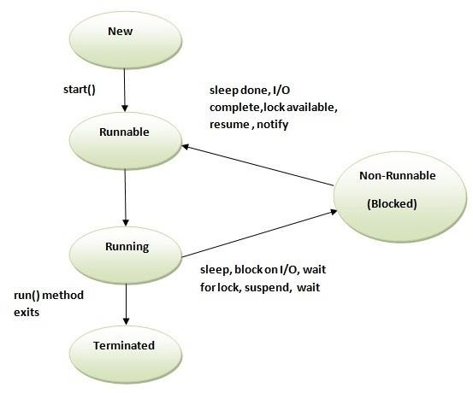
Thread Lifecycle
www.cybage.com

Slide 9
Thread Class Methods
The Thread class defines a number of methods useful for thread management.
These include static methods, which provide information about, or affect the
status of, the thread invoking the method.
The other methods are invoked from other threads involved in managing the thread and Thread object.
www.cybage.com

Slide 10
Thread Class Methods Continued..
Thread.sleep : causes the current thread to suspend execution for a specified period.
This is an efficient means of making processor time
available to the other threads of an application
t.join
: This blocks the current thread from becoming runnable until after the thread referenced by t is no longer alive. The join method allows one thread to wait for the completion of another
Thread.yield
: makes the currently running thread head back to runnable to allow other threads of the same priority to get their turn
the intention is to promote graceful turn-taking among equal-priority threads.
www.cybage.com

Slide 11
Thread Priorities
Threads always run with some priority, usually represented as a number between 1 and 10
Thread priority can be set using method setPriority( x)
Thread class has the three following constants (static final variables) Thread.MIN_PRIORITY (1)
Thread.NORM_PRIORITY (5)
Thread.MAX_PRIORITY (10)
www.cybage.com

Slide 12
Thread Synchronization
Multithreading may introduce some kind of errors :
thread interference
and
memory consistency errors
The tool needed to prevent these errors is synchronization
www.cybage.com

Slide 13
Thread Synchronization
thread interference :
Interference happens when two operations, running in different threads, but acting on the same data, interleave. This means that the two operations consist of multiple steps, and the sequences of steps overlap.
memory consistency errors:
Memory consistency errors occur when different threads have inconsistent views of what should be the same data
www.cybage.com

Slide 14
Thread Synchronization
Synchronization is built around an internal entity known as the intrinsic lock or monitor lock.
Every object has an intrinsic lock associated with it.
By convention, a thread that needs exclusive and consistent access to an object's fields has to acquire the object's intrinsic lock before accessing them, and then release the intrinsic lock when it's done with them.
A thread is said to own the intrinsic lock between the time it has acquired the lock and released the lock.
As long as a thread owns an intrinsic lock, no other thread can acquire the
same lock. The other thread will block when it attempts to acquire the lock.
www.cybage.com

Slide 15
Thread Synchronization
Locks In Synchronized Methods:
When a thread invokes a synchronized method, it automatically acquires the intrinsic lock for that method's object and releases it when the method returns.
The lock release occurs even if the return was caused by an uncaught exception.
Synchronized Statements:
Another way to create synchronized code is with synchronized statements.
Unlike synchronized methods, synchronized statements must specify the object that provides the intrinsic lock:
www.cybage.com

Slide 16

www.cybage.com

Slide 17
Thank You!
www.cybage.com
Copyright © 2019 Cybage Software Pvt. Ltd. All Rights Reserved. Cybage Confidential._{11/12/2020} www.cybage.com 17

